Slide 1
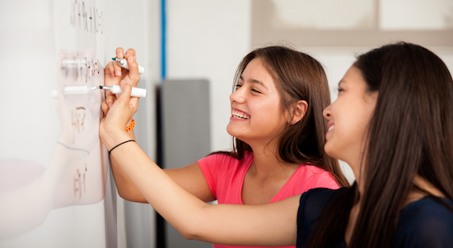
Problem Solving Session
The remainder of today’s class will comprise the problem solving session (PSS).
Your instructor will divide you into teams of 3 or 4 students.
Each team will work together to solve the following problems over the course of 20-30 minutes.
You may work on paper, a white board, or digitally as determined by your instructor.
You will submit your solution by pushing it to GitHub before the end of class.
Your instructor will go over the solution before the end of class.
Class participation is a significant part of your grade (20%). This includes in class activities and the problem solving session.
Your graders will grade your participation by verifying that you pushed your solutions before the end of the class period each day.

Slide 2
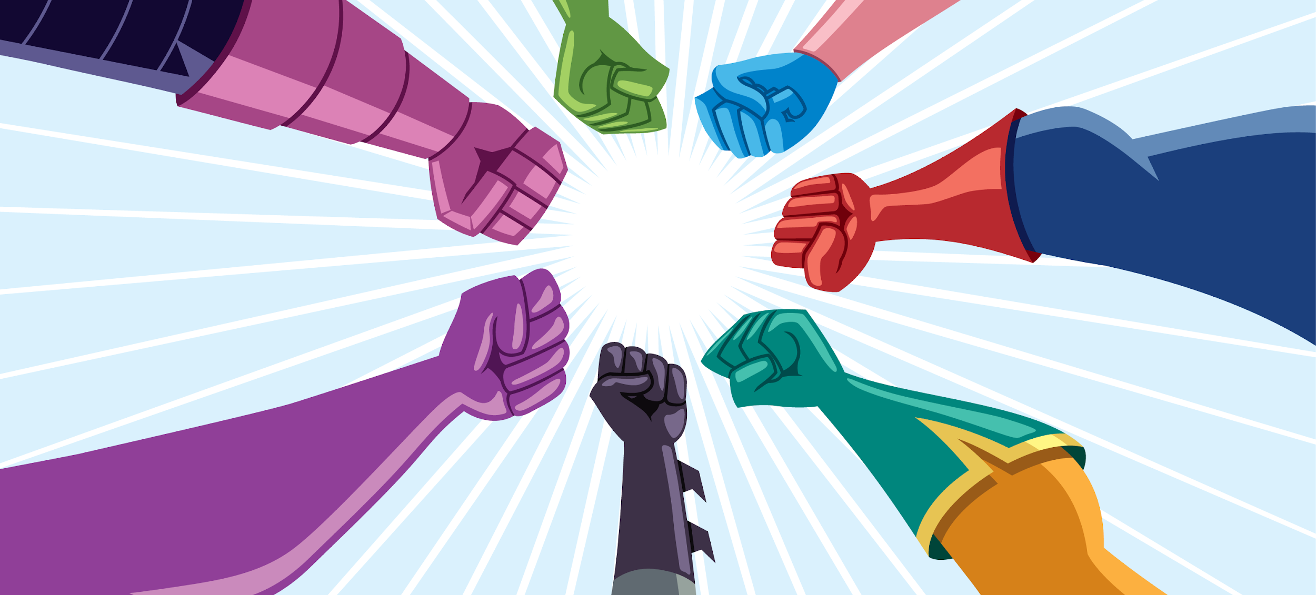
Problem Solving Team Members
Team Member Name | Check if did not do anything
Record the name of each of your problem solving team members here.
Do not forget to add every team member’s name! Your instructor (or course assistant) may or may not use this to determine whether or not you participated in the problem solving session.

Slide 3
Relative Coordinates
Some coordinate systems. Which one does turtle use?
While most 2-dimensional coordinate systems are based on an x,y axis pair, the location of the x/y intersection can vary. Rather than thinking of the whole system as one set of coordinates you can think of each object having its own relative coordinate system where the x/y intersection is a point on the larger world coordinate system.
For problem solving today we'll explore a couple coordinate systems and ways to move between them. For the homework, you'll use one of them as the relative coordinate system for drawing shapes in turtle.

Slide 4
Problem 1
200
Assume you are working in a turtle window of size 200x200. Using the draw_square from class, draw a picture of the following code:
turtle.pendown ()
draw_square (50, "")
Label the coordinates of each of the square's corners.
0,0
50,0
0,-50
50,-50
Using the color "" will cause the square to not be filled
Notes:
Solution:
(100, 100)
(150, 100)
(150, 150)
(100, 150)

Slide 5
Problem 2
200
Now consider a common alternative coordinate system where everything is based on the upper left-hand corner. Thus 0, 0 in this system would be the upper, left-most location. Increasing x moves to the right, increasing y moves down.
Assume you are working in a turtle window of size 200x200. Using the draw_square from class, draw a picture of the following code:
turtle.pendown ()
draw_square (50, "")
Label the coordinates of each of the square's corners.
100, 100
150, 100
100, 150
150, 150
Notes:
Solution:
(0, 0)
(50, 0)
(50, 50)
(0, 50)

Slide 6

Problem 3
turtle.xcor() returns the turtles current x-coordinate.
turtle.ycor () returns the turtles current y-coordinate.
Use these two functions to write a test for goto(x, y).
Should I be here?

